Slide 1

Learning Graphql
Declarative Data Fetching For Modern Web Apps

Slide 2
Overview
What is Graphql?
REST Drawbacks that solved by Graphql
Graphql Schema
Graphql Query
Security
Demo

Slide 3
What is Graphql?

Slide 4
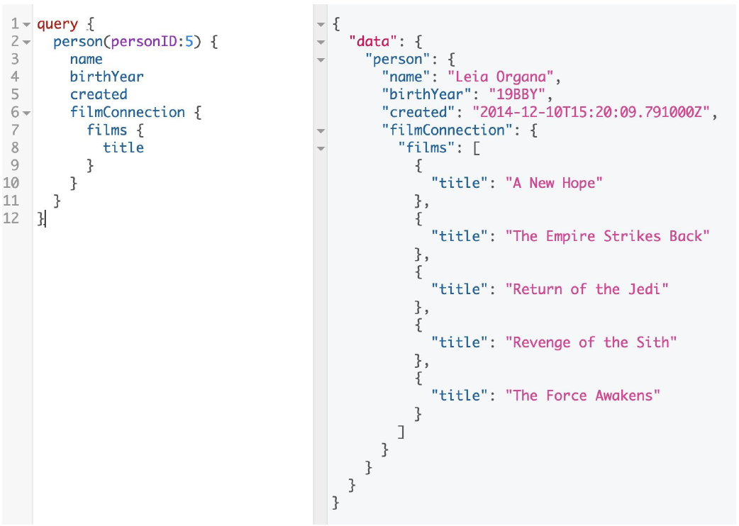
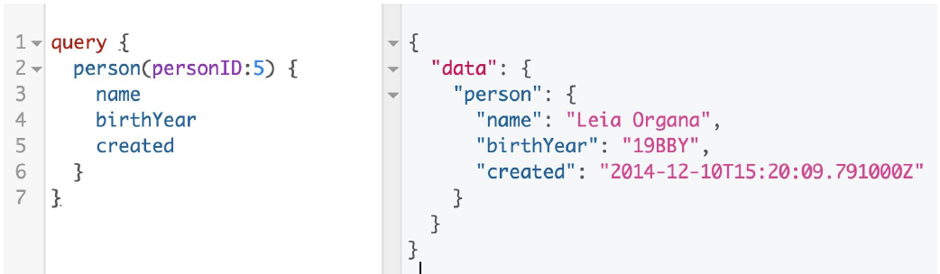
What is Graphql?
GraphQL is a query language for APIs and a runtime for fulfilling those queries with your existing data

Slide 5
Design Principles of Graphql
Hierarchical
Product Centric
Strong Typing
Client –specified queries
Instropectives

Slide 6
REST Drawbacks that solved by Graphql

Slide 7
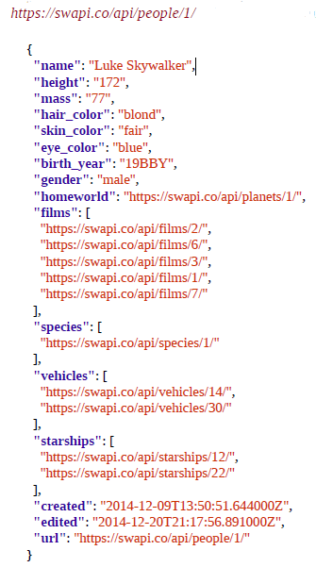
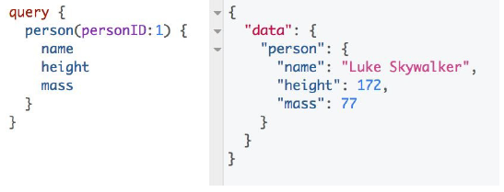
REST Drawbacks that solved by Graphql
Overfetching

Slide 8
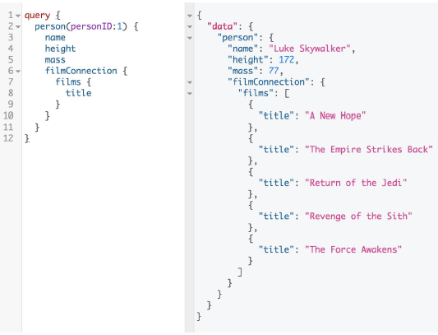
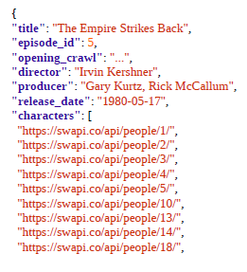
REST Drawbacks that solved by Graphql
Underfetching

Slide 9
REST Drawbacks that solved by Graphql
Managing REST endpoint
GET /api/character/{id}
GET /api/character-summary
GET /api/character-details-with-film-title
POST /api/graphql

Slide 10
Graphql Schema

Slide 11
Graphql Schema
In Graphql instead of looking at APIs as a collection of REST endpoints, we are going to begin looking at APIs as collection of types (schema)
GraphQL has its own type system that’s used to define the schema of an API. The syntax for writing schemas is called Schema Definition Language (SDL).

Slide 12
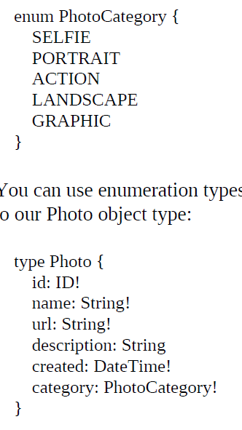
Graphql Schema – Defining Types
Type is the core unit of any graphql schema
Object types and fields
Scalar Types
Int
Float
String
Boolean
ID
Enum

Slide 13
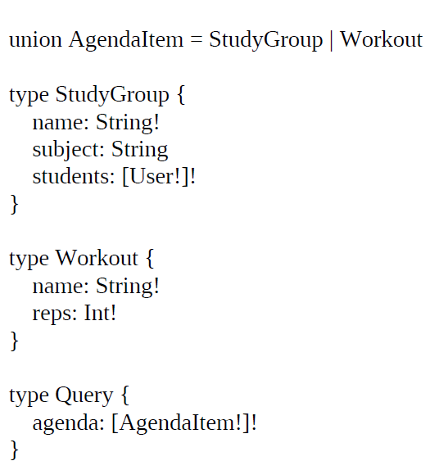
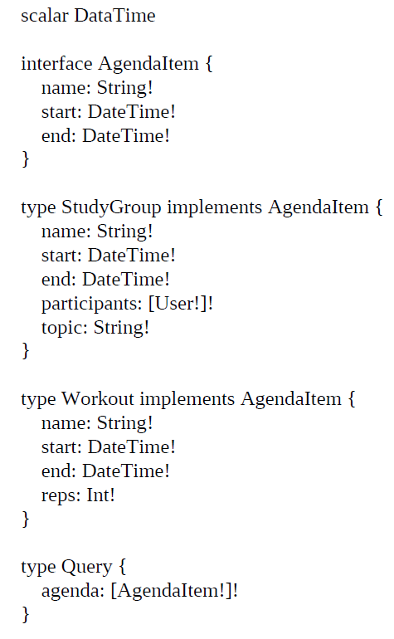
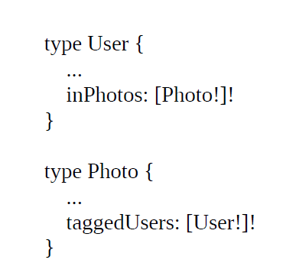
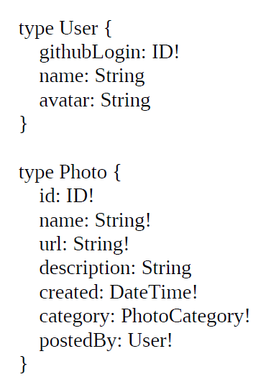
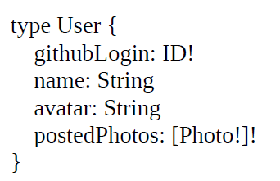
Graphql Schema – Connection and Lists
One to one
One to many
Many to many
Union
Interface

Slide 14
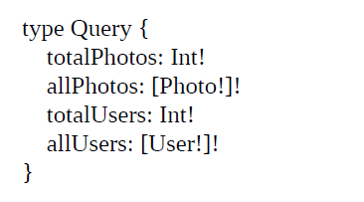
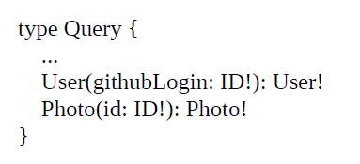
Graphql Schema – Query

Slide 15
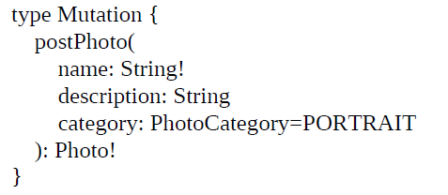
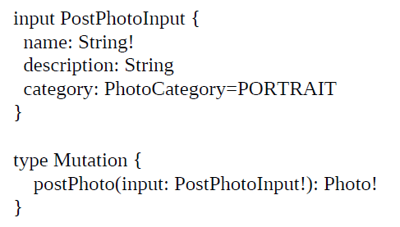
Graphql Schema – Mutations

Slide 16
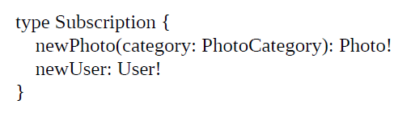
Graphql Schema – Subscriptions

Slide 17
Graphql Query

Slide 18
Graphql Query
Graphql has 3 root types
Query
Mutation
Subscription

Slide 19
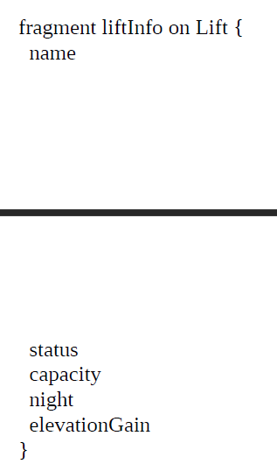
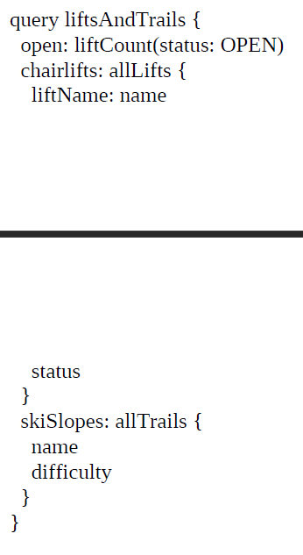
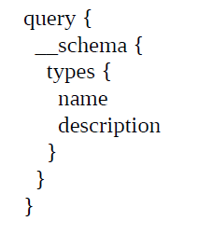
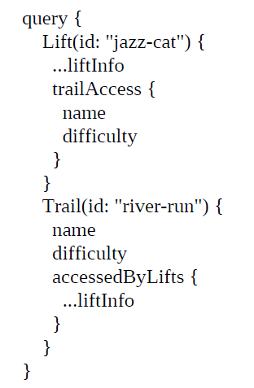
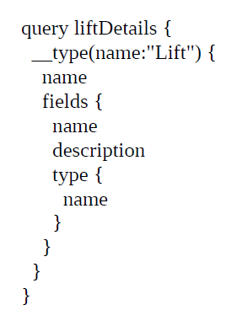
Root types – Query

Slide 20
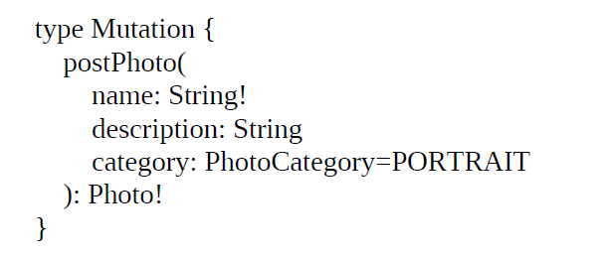
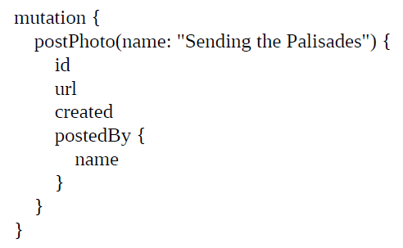
Root Type - Mutation
Schema
Query

Slide 21
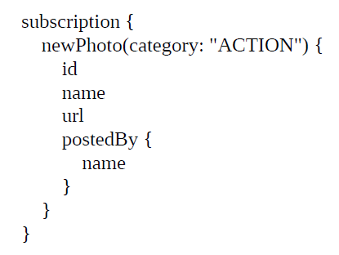
Root Type - Subscription
Schema
Query

Slide 22
Security

Slide 23
Security
Set Request Timeout
Data Limitations
Limiting Query Depth
Limiting Query Complexity

Slide 24
DEMO

Slide 25
Reference
https://learning.oreilly.com/library/view/learning-graphql/9781492030706/
https://graphql.org/learn/
https://www.youtube.com/watch?v=I3NBPHA5coo

Slide 26
THANK YOU

